Slide 1
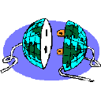
CISC 250 – Business Telecomm Networks
Network Security

Slide 2
Today’s Outline
Types of Security Threats or Attacks
Types of Security Systems
Prevention
Authentication
Encryption
Firewall
Detection
Correction
Security Solutions
Social Engineering

Slide 3
Internet Security
The problem
The Internet was not designed to be secure
Security was an afterthought
Three sides of Internet Security
Confidentiality
Information must only be available to authorized parties
Integrity
Information must not be modified in unexpected ways
Availability
Information must be available to those who need it
Notes:
The Internet was created by DARPA intended for defense (closed use)
Originally called the Arpanet
Everyone was an “Unrestricted” insider on the network so security was not much of a problem.
It was not designed to be a secure public network
It was designed as a military network that could withstand a public attack

Slide 4
Types of Internet Attacks (1)
Probes
Scans
Account compromise
Root account compromise
Notes:
UNIX Crack is an example of an account compromise attempt.
Probes often performed on blocks of address
New internet accounts
Universities

Slide 5
Types of Internet Attacks (2)
Packet sniffer
Malicious code
Trojan horses
Viruses
Worms
Denial of service
Notes:
Note more on denial-of-service in subsequent slides.
Trojan horses
Often downloaded along with another application
Remains dormant on the host computer for a period of time before beginning the attack.
The Morris work appeared in 1988 was considered the first automated computer security incident.
Robert T. Morris was a student at Cornell University at Ithica New Work.
About 10% of the Internet’s computers stopped at the same time.
The Internet Worm
11/3/88 (Black Thursday)
Exploit security holes in the UNIX operating system
Finger
Sendmail
Discuss how it worked

Slide 6
Denial-of-Service (DoS)
Make the system unavailable (crash it or make it run very slowly) by sending one message or a stream of messages. Loss of availability.
Single Message DOS Attack
(Crashes the Victim)
Server
Message Stream DOS Attack
(Overloads the Victim)
Attacker
Server
Attacker

Slide 7
Denial-of-Service (DoS)
Distributed DOS (DDoS) Attack:
Messages Come from Many Sources
Attack
Command
DoS Attack Packets
Computer with
Zombie
Attack
Command
Attacker
Server
DoS Attack Packets
Computer with
Zombie
DDoS Solutions - http://www.youtube.com/watch?v=7B9Sq4DNFBo

Slide 8
Types of Security Systems
Preventative – restrain, stop a person from acting or hinder an event from occurring.
Detective – reveal or discover any kind of unwanted events.
Corrective – rectify an unwanted event or a trespass.

Slide 9
Preventative – Authentication
Ensure that users attempting to gain access to networks are really who they claim to be
Password protection
Current Authentication Technologies
What you know
What you have
Smart card
What you are
Biometric authentication – fingerprints, facial geometry, voice recognition…
(https://www.youtube.com/watch?v=MgWNmWRBaVk )
Passwords are like Underwear... Change yours often!
Passwords are like Underwear... Don't leave yours lying around!
Passwords are like Underwear... Don't share them with friends!
Passwords are like Underwear...
The longer the better!
Passwords are like Underwear... Be mysterious!

Slide 10
Preventative – Encryption
Changing data into an indecipherable form before transmission
Even if the data is somehow intercepted, they cannot be interpreted!
The changed unmeaningful data is known as ciphertext
The unecnrypted data is known as plaintext

Slide 11

Private Key Cryptography
PLAIN TEXT
CIPHER TEXT
Unsecured Communication Channel
Shared Secret Key
PLAIN TEXT
CIPHER TEXT

Slide 12
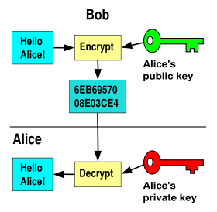
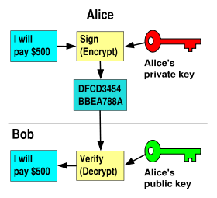
Public Key Cryptography
Public Key Encryption
Digital Signature

Slide 13



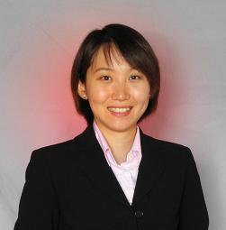
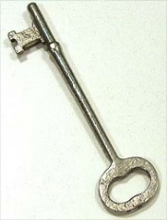
Example – SSL/TLS in eCommerce
SSL handshake process: http://www.youtube.com/watch?v=JjMfuJOnHzc
Bank’s Private Key
Encrypted
Credit Card Info
Encrypted
Other Info
Merchant
Seller’s Private Key
OpenSSL Heartbeat (Heartbleed): https://www.youtube.com/watch?v=hTK0pywfmDE

Slide 14
Preventative – Firewall
A firewall is a specialized software that runs on a router, gateway, or special purpose computer to examine packets flowing into and out of a network and restrict access to the organization’s network.
Two Types of firewall:
Packet level (packet filter) firewall
Application level firewall (proxy server)

Slide 15
Packet Filter Firewall
Corporate Network
The Internet
IP-H
TCP-H
Application Message
Permit
IP-H
UDP-H
Application Message
IP-H
ICMP Message
Packet
Filter
Firewall
Arriving Packets
Examines Packets in Isolation Fast but Misses Some Attacks
Deny

Slide 16
Packet Filter Firewall (Access Control Lists)
ACLs permit or deny packets passing through a firewall
Check whether the interface is internal or external
Check port numbers
Check source and destination IP address
ACL rules are executed in order
It’s easy to misconfigure ACLs

Slide 17
Enterprise Firewall Architectures
The Internet
Legitimate customers, business partners, hackers
DMZ – demilitarized zone
External private network
Intranet – secure network
Internal private network

Slide 18
Detecting Unauthorized Access
Looking for anything out of the ordinary
Logging all messages sent and received by the network, all software used, and all logins (or attempted logins) to the network
Regular monitoring should also be extended to network hardware

Slide 19
Security Probes & Intrusion Detection
Security Probes – vulnerability scanners
Test, report, suggest
Nessus, Nmap
Intrusion Detection
Identify traffic patterns
Cisco IDS, Snort

Slide 20
Workplace Security Solutions (1)
Passwords
One-time passwords
Use of strong passwords
Require regular password changes
E-mail
Unencrypted e-mail can be read as it moves through the network
Source of viruses from attachments and scripts
Employ e-mail virus scanning software

Slide 21
Workplace Security Solutions (2)
Untrusted software
Restrict download of untrusted or unknown software
Require standard computer configurations
Physical
Restrict access to computer room and trusted terminals
Restrict access to physical site
Social Engineering
Train personnel against social engineering attacks

Slide 22
Home Security Solutions (1)
Operating system
Install updates and patches
Configure chat programs
Firewalls
Microsoft Office and e-mail
Do not run untrusted Office macros
Encrypt sensitive e-mail
Use care when opening e-mail attachments
Beware of e-mail spoofing

Slide 23
Home Security Solutions (2)
General security measures
Install and use anti-virus programs
Backup important files and folders
Use strong passwords
Don’t enable file sharing
Beware of wireless networks

Slide 24
Social Engineering (Introduction)
Using human relationships to attain a goal
Intruders use social engineering to illegally compromise corporate assets

Slide 25
A Quote from Kevin Mitnick
“You could spend a fortune purchasing technology and services from every exhibitor, speaker and sponsor at the RSA Conference, and your network infrastructure could still remain vulnerable to old-fashioned manipulation.”

Slide 26
Social Engineering (Tactics)
Social engineers try to establish trust
Pretend to provide help to victim (reverse social engineering)
Attempt to gain access
Kevin Mitnick fakes way into LA Telco Central Office http://www.youtube.com/watch?v=8L76gTaReeg
Kevin Mitnick live hack in Def-Con http://www.youtube.com/watch?v=DB6ywr9fngU

Slide 27
Types of Attacks
Phishing
Impersonation on help desk calls
Physical access (such as tailgating)
Shoulder surfing
Dumpster diving
Stealing important documents
Fake software
Trojans

Slide 28
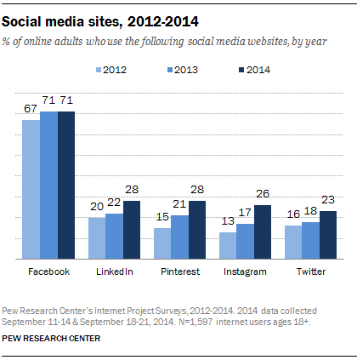
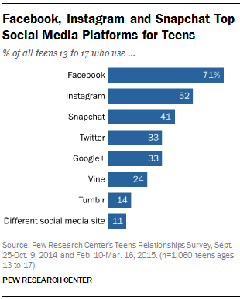
Social Networking

Slide 29
Things to consider on your Social Networking sites
Maiden Name
Photo’s that unknowingly reveal information
“Check-in”
Common way to get information about a SPECIFIC person: reunion.com
Put your name in “images.google.com” or spokeo.com see what comes up.
Photos that you are “tagged” in
Programs/games on social networking sites

Slide 30
Social Engineering (Defenses)
Establish password policies
Classify data based on risk and sensitivity
Define acceptable use policies
Perform background checks
Define rigorous termination policies
Define physical security policies
Perform ongoing security awareness training
Deception Detection Tools: Avatar in Arizona

Slide 31
Security Organizations
(CERIAS) Mission is to enhance public awareness of information protection
www.cerias.org
(CERT) Analyze and report on the state of Internet security
www.cert.org
(SANS) Operates an early warning system
www.sans.org

